Slide 1
TrendWave
9/12/2024
.
Kexuan Chen | kexuanch@andrew.cmu.edu
Yanijing Huang | yanjingh@andrew.cmu.edu
Swapnil Panwala | spanwala@andrew.cmu.edu
Hetong Wang | hetongw@andrew.cmu.edu

Slide 2
AGENDA
Vision
Team
Problem
Approach / Solution
Market
Business Model
Competition
Go-to-Market

Slide 3
VISION
TrendWave, the social media trend app for SMBS and creators

Slide 4



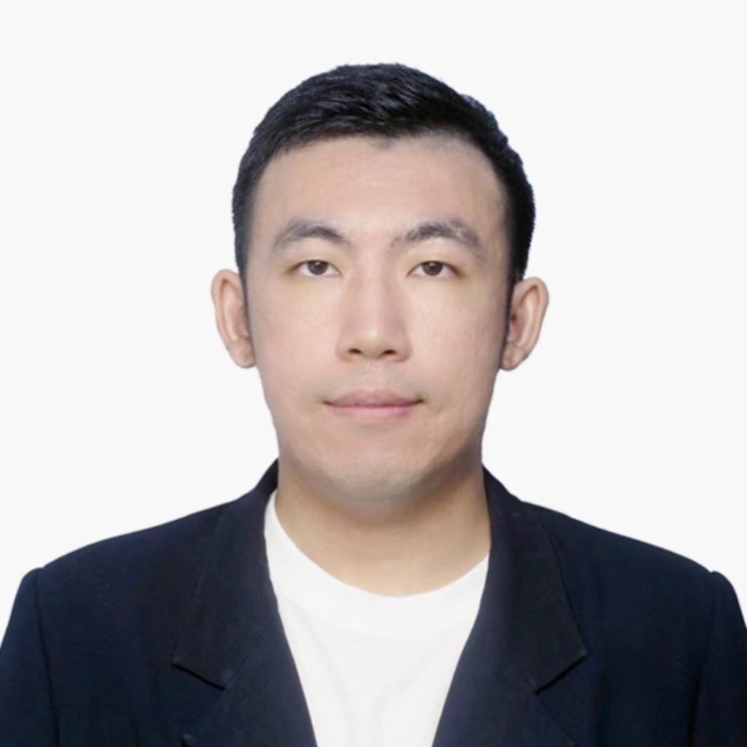
TEAM
Kexuan Chen
Title: Co-founder & CAIO (Chief AI Officer)
https://www.linkedin.com/in/kexuanchen/
Swapnil Panwala
Title: Co-founder & CTO
https://www.linkedin.com/in/spanwala/
Yanijing Huang
Title: Co-founder & CEO
https://www.linkedin.com/in/yanjinghuang/
Hetong Wang
Title: Co-founder & CDO (Chief Data Officer)
www.linkedin.com/in/hetong-wang-b332b1246

Slide 5
Problem: SMBs & Content Creators' Instagram Struggle
Customer pain point
• Lack of dedicated social media teams
• Ineffective, retrospective analytics tools
• Gap in predictive and tailored analysis for SMBs
Overwhelming trend complexity and limited resources & time
Current solution
• Focus on past performance & current trends
• General analytics & content scheduling
Estimated Cost
• $50 - $800+/month
• Enterprise solutions: thousands/month
Factors resulted in the pain point
• Overwhelming data without clear insights
• Designed for large businesses or big content creators, not SMBs
• Retrospective focus vs. predictive trends

Slide 6
SOLUTION / PRODUCT
Product features
• Advanced trend forecasting before mainstream adoption
• User-friendly dashboards with actionable insights
• Customizable reports for specific industries/niches
• AI-powered content strategy suggestions
• Automated trend research
Value proposition
Empower SMBs and content creators to stay ahead of Instagram trends
optimize marketing strategies
Boost engagement without extensive resources or time investment
Customer impact (proposed)
• Time Saved: 10+ hours/week on trend research and content planning
• Engagement Boost: Average 30% increase in post engagement
• Follower Growth: 25% faster follower acquisition rate
• ROI: 3x improvement in social media marketing ROI

Slide 7
MARKET
Market / target customer
Small-medium companies
Individual Influencers
Entrepreneurs and Startups
Market size
The global social media management market size was valued $14.4 billion in 2021 and is expected to reach $41.6 billion by 2026, growing at a CAGR of 23.6% (source: MarketsandMarkets).
Market forces / drivers —- we do this part verbally, not on slides
The rapid growth of social media users and the demand for real-time analytics are driving businesses to leverage social media insights for competitive advantage.
The integration of AI and machine learning enhances predictive analytics and sentiment analysis, providing deeper customer insights.
Increasing adoption of social media analytics by SMEs and the rise of influencer marketing further fuel market expansion and product development opportunities.

Slide 8
BUSINESS MODEL / UNIT ECONOMICS
Freemium Model
Basic features (News & Blog-post): Free
Premium features: Subscription-based
Tiered Pricing Structure
Individual Creator: $19.99/month
Small Business: $49.99/month
Agency: $149.99/month
API Access
Custom pricing for integration with other tools
Key Metrics
Average Order Value (AOV): $39.99

Slide 9
COMPETITION
Who are the key players?
Direct competitors:
Hootsuite Insights
Sprout Social
Later
Indirect competitors:
General social media management tools (Buffer, Planoly)
Manual trend research methods
How are you differentiated?
Specialized focus on trend prediction for Instagram and other social medias
Targeted for small and medium sized companies who want to stay ahead of trends and gain a competitive edge
Affordable pricing compared to enterprise solution and solutions offered by our competitors

Slide 10
LAUNCH STRATEGY / GO-TO-MARKET
What is your customer acquisition approach?
Content Marketing:
Blog posts, infographics, and videos showcasing trend predictions and success stories of using TrendWave including the impacts
Free resources and guides on how to use TrendWave
Free Trial and and Referral Program:
Offer a 14-day free trial with full access to features
Implement a referral system with incentives for existing users to invite others
Community Building:
Create a TrendWave user community for sharing success stories and tips
Provide excellent customer support and regularly collect feedback for continuous improvement

Slide 11
LAUNCH STRATEGY / GO-TO-MARKET
What are key drivers and potential milestones?
Active user number and retention rate are two very big key drivers, as it marks how popular the tool is and does it really help the user achieve their purpose.
Strategies listed in the previous slide will help us attract and acquire more new users!

